Slide 1
John Wilton
Regional Business Consultant
Phone 216-584-0307
Email: john.wilton@bwc.state.oh.us

Slide 2

Today’s Learning Objectives
You’ll learn about:
Recent rate changes;
The three elements of A Billion Back;
The reasons for switching to prospective billing;
The differences with prospective billing and what they mean to you;
Significant dates and deadlines.

Slide 3
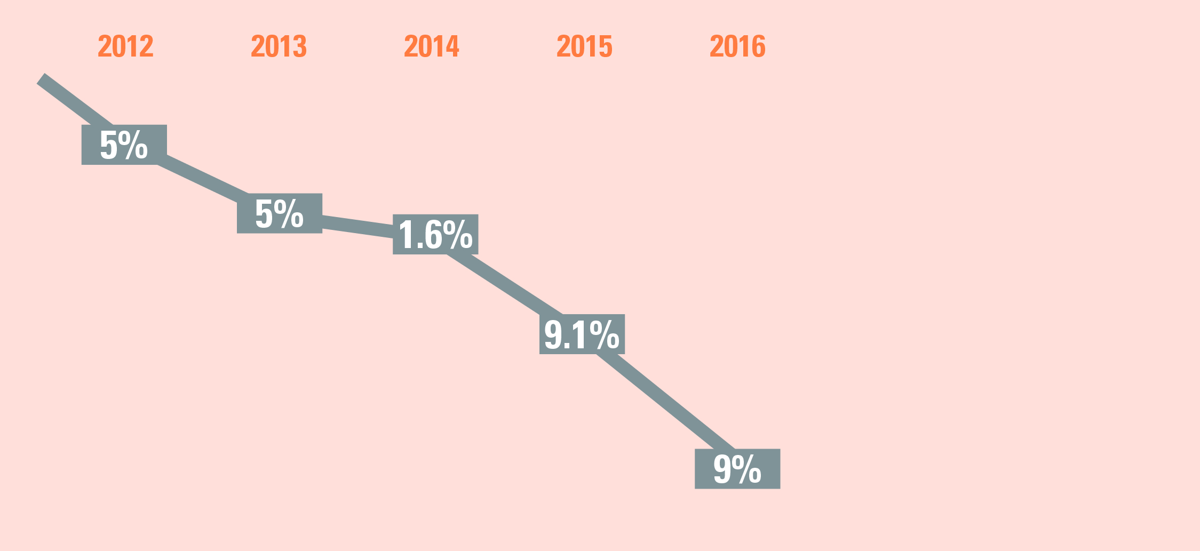
Public Employer Rate Cuts
^{Public} employer taxing district rate reductions (2012 – 2016)
Total average decrease to local government rates
of 26.5% since 2011
Lowest rates in more than 30 years
Total average decrease to local government rates
of 26.5% since 2011
Lowest rates in more than 30 years

Slide 4
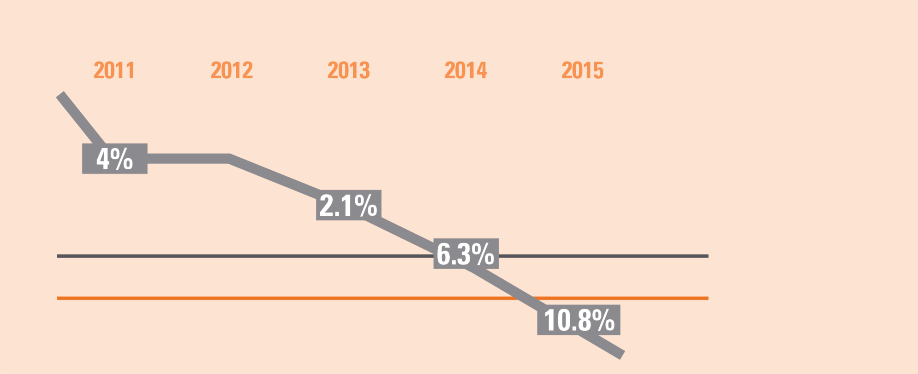
Ohio’s Workers’ Compensation Rates
Private employer rate reductions (2011 – 2015)
Beginning July 2015, private employer RATES WILL BE 21.4% LOWER than the rates from January 2011.
^{$1.85}
^{NATIONAL}
^{MEDIAN1}
^{$1.74}
^{OHIO}
^{WORKERS’ COMP COSTS}
1 2014 Oregon Premium Rate Ranking Study (per $100 of payroll)

Slide 5
BWC: A Partner in Ohio’s Economic Growth
Since 2011
Reduced average rates nearly 30%
Cumulative savings to date $1 billion
Strong investments, conservative management
Two $1 billion rebates

Slide 6
BWC: A Partner in Ohio’s Economic Growth
Initiatives since 2011 =
$4.3 billion more for Ohio employers!

Slide 7
BWC: A Partner in Ohio’s Economic Growth
Since 2011
A modern, flexible billing system
$1.2 billion in credits
Tripled safety grants to $15 million annually
$40 million in grants

Slide 8

Increased Commitment to Safety
Last year, BWC awarded $15 million in safety grants to 539 employers.
$15 million will also be available to employers this year and next.
  Fiscal year July 1, 2015 – June 30, 2016 – SPENT!
  As well as July 1, 2016 – June 30, 2017-
    Early April, 2016 open to apps

Slide 9
Safety Grants
Grants to assist employers in purchasing equipment that will substantially reduce or eliminate injuries
3-to-1 matching funds (up to $40,000)
Last year, BWC awarded $15 million in grants to 539 employers
Have you applied for your safety grant? If not … what are you waiting for?
Notes:
3-to-1 matching grants (up to $40,000)
Helps employers purchase equipment to reduce workplace injuries

Slide 10
Program Results
Notes:
Explain slides….
Safety does not need a grant to have this type of an impact on improving safety in the workplace. Creating a safer work environment in your business can help reduce the frequency or likelihood of an accident.
Motivation for improving safety also comes in the form of dollars….

Slide 11
Overview of
Prospective Billing
Notes:
BWC is moving in this direction because it is good business. Prospective Billing is an industry best practice and a change we’ve wanted to make for over 20 years. Normally to make this kind of switch, a double payment would need to be made but as BWC has been fiscally responsible and good stewards of our fund, we are able to cover the cost of a transition credit so no employer will be double billed because of this change.”

Slide 12

Why Transition to Prospective Billing?
Industry standard
More flexible payment options
Decrease in base rates by 4%
Increased ability for us to detect non-compliance and fraud
Notes:
Rate decrease is due to the time value of money – discount rate is currently 4%

Slide 13
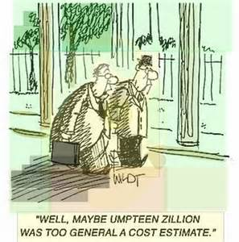
Implementing Prospective Billing
BWC will base estimated premium on the most recently reported policy year.
Each year employers will receive a Notice of Estimated Annual Premium and their annual certificate of coverage.
Notes:
If the employer does not agree with the BWC estimate, there will be a process for the employer to contact BWC for a change. Employer will not be able to make this change on-line initially. There is no penalty if their estimate is low as long as when they true-up, they pay.
Annual Certificate will state that it does not guarantee coverage, coverage is based upon premium payment

Slide 14
Implementing Prospective Billing
BWC will always use the most recently reported policy year to estimate an individual employer’s premium obligation.
  BWC used the July 1, 2013 - June 30, 2014, payroll for policy year 2015. (Private Employer)
  BWC used the January 1, 2014 – December 31, 2014 payroll for policy year 2016. (Public Employer)
Notes:
If the employer does not agree with the BWC estimate, there will be a process for the employer to contact BWC for a change. Employer will not be able to make this change on-line initially. There is no penalty if their estimate is low as long as when they true-up, they pay.
Annual Certificate will state that it does not guarantee coverage, coverage is based upon premium payment

Slide 15
Implementing Prospective Billing
In May of each year: (Private Employers)
  Employers will receive a notice of estimated annual premium along with their annual certificate of coverage.
The 2017 Notice of Estimated Annual Premium will be sent by Oct. 31, 2016. (Public Employers)
Notes:
If the employer does not agree with the BWC estimate, there will be a process for the employer to contact BWC for a change. Employer will not be able to make this change on-line initially. There is no penalty if their estimate is low as long as when they true-up, they pay.
Annual Certificate will state that it does not guarantee coverage, coverage is based upon premium payment

Slide 16

Installment Options – Starting 2017
  Annual (1);
  Semi-annual (2);
  Quarterly (4);
  Bi-monthly (6);
  Monthly (12).
Minimum payers ($120 + fees and assessments) will not receive installment options.
Notes:
The default installment plan is (monthly)
No installment fees
Minimum payers premium due by Dec. 31 each year.

Slide 17
Payroll True-up Report
Prospective requires an annual payroll report true-up. BWC will send a reminder in July of each year.
The employer must report actual payroll for the previous policy year.
  Online or over the phone only
  If additional premium is calculated, it is also due by Aug. 15.
  If credit calculated, it will be released in normal process.
  Employers must pay online to be eligible for the Go-green rebate.
Notes:
**Online is the preferred option- if the employer chooses not to utilize the online application, they will not be eligible for the go green discount (even if all other premium was paid online.
Because their premium is based on an estimate, it is necessary for our customers to give us actual figures, so BWC can reconcile the difference.
Employer will be encouraged to report large changes to lessen true-up amount at end of policy year (manual code changes, large shifts in payroll)

Slide 18

Payroll True-up Report
Actual payroll is critical for rate setting. For that reason, any outstanding true-ups will result in:
  Immediate disqualification from rating plans and programs for that current policy year;
  Ineligibility to receive any rebates for the programs completed in the previous policy year;
  Ineligibility for rating plan or programs in the upcoming program year.

Slide 19

Payroll True-up Report
Failure to complete* the payroll true-up report will result in immediate disqualification from rating plans and programs.
*Complete = reporting and paying (if necessary).
Notes:
Actual payroll is critical for rate setting. For that reason, any outstanding true-ups will result in:
Immediate disqualification from rating plans and programs for that current policy year;
Ineligibility to receive any rebates for the programs completed in the previous policy year;
Ineligibility for rating plan or programs in the upcoming program year.

Slide 20

Lapsing Coverage
Coverage will lapse if installment is not paid on time.
BWC will not lapse an employer who does not true-up, but BWC will certify to the Attorney General’s office.

Slide 21

BWC E-account
E-Account User ID and Password
  Different from your account number
  User specific
  Primary User
  Secondary User
Your BWC E-account gives you access to claim and policy information.
  Report and pay online
  Review individual claims and transaction history
  Complete year-end true-up
Notes:
John
One page slide on the simplicity of setting up an e-account (see if Kim can get this from Erik)
An e-account (user ID and password) allows you to access personal, secure information about your individual claim or policy. To do e-business with BWC, you should create an e-account.
Note: Your claim or policy number is different from your e-account. You must create an e-account on this Web site. While a BWC employee may ask you for your claim or policy number, NO BWC employee will ask for your e-account (user ID and password). Do not give your e-account to anyone.
Here is some additional information that will help you create and manage your e-account.
Primary user
A primary user is the person who creates the first e-account. The primary user manages that e-account. This includes adding secondary users, deleting secondary users and transferring primary status to another user.
Secondary user
For those organizations that have multiple individuals who need access to their information online, i.e., several people in the human resources department of a large company who manage workers' compensation, BWC offers a secondary e-account. The primary user is the only person that can add or delete secondary users for that e-account. Secondary users can access the same information as the primary user.
Click here to add secondary users to your e-account.
Note: Injured workers cannot add secondary users to their e-accounts. However, they can authorize online designees to act on their behalf.
Online designee
An online designee is anyone (family member, spouse, friend, attorney, etc.) you authorize to access personal, secure information on BWC's Web site. This means the online designee can act on your behalf online, i.e. submit a BWC form online. Online designees only have this type of access on this Web site. They cannot represent you at any hearings or receive copies of any correspondence from BWC unless they are an authorized representative.
Click here to update your online designee associations.
Note: If you already have a BWC authorized representative, you do not need to make them an online designee. BWC will automatically recognize that existing relationship. However you must create an e-account for yourself before your representative can access your information online. Then, representatives need to create their own e-accounts, and they will have access to information for the clients with which they are associated.
Legal authorized representatives
Injured workers and employers have the right to hire an authorized representative or third party administrator (TPA) to represent them in workers' compensation matters. BWC has approved these individuals or entities through our formal authorization process. You cannot add, change or terminate an authorized representative through this Web site. However, you can get the information you need to begin the process here. Click here for more information on adding or changing your authorized representative.
If BWC has not formally authorized your legal representative, you can still make them an online designee until BWC completes the authorization process. You can add or delete an online designee through this Web site. All designees must be registered with BWC first. Then you can add them to your e-account as an online designee, which gives them access to all of your secure information online.
Finally, if you dismiss your legal authorized representative, you must delete that representative as an online designee. Simply dismissing a representative in writing does not terminate access to secure information on our Web site. You must delete the online designee from your e-account to terminate online access.

Slide 22
Rating Plan and Program Deadline (Private Employers)
Group-experience rating – Monday prior to Thanksgiving
Group retro, One Claim Program, Deductible, Individual retro – Last business day in January
Destination: Excellence programs – Last business day in May
Notes:
If the last business day falls on a weekend, the next business day will apply

Slide 23

Key Dates to Remember
(Public Employers)
May 2016 – 2015 payroll report payroll and first installment
September 2016 – second invoice and remaining premium due
November 2016 – Notice of Estimated Annual Premium
December 2016 – First installment for policy year 2017
February 2017 – First payroll true-up report due

Slide 24
Public Employer Timeline
Dec. 2015
2016 notice of estimated annual premium and 2015 payroll report mailed
March 31, 2016
2016 invoice mailed
July 29, 2016
Group retro, one claim program, Deductible and Individual retro
May 16, 2016
2015 payroll report (min. 50% due) and 2016 invoice due
Sept. 1, 2016
Remaining 2015 and 2016 premium due
Nov. 30, 2015
Destination: Excellence enrollment
May 31, 2016
Group enrollment Jan. 1, 2017-Dec. 31, 2017
Jan. 1, 2016
July 1, 2016
Transition credit
MCO open enrollment
Destination: Excellence enrollment – Last business day of November
Dual premium billings: Payroll report and prospective invoice due May 16 – transition credit on both
2nd invoice in 2016 for both policy year 2015 and 2016 due Sept. 1 (again, transition credits on both)

Slide 25
Public Employer Timeline
Oct. 31, 2016
Notice of estimated annual premium mailed for 2017 policy year
Dec. 1, 2016
Invoice mailed for
policy year 2017
Jan. 2, 2017
1st installment due**
Jan. 2, 2017
Payroll true-up report notice sent
Nov. 30, 2016
Destination: Excellence enrollment
Feb. 15, 2017
Payroll true-up due
January 2017
Transition credit
Policy year 2017 notice of estimated annual premium sent late October.
Policy year 2017 invoice sent Dec. 1; due Dec. 31.
Payroll true-up report sent Jan. 2, due Feb. 15.
**Deferred payment option can be used.

Slide 26
Private Emp. Policy Year – May 1, 2016 and Beyond
Jan. 29, 2016
Group retro, One Claim Program, Individual retro, and Deductible enrollment
June 1, 2016
Invoice mailed for July 1, 2016 to June 30, 2017 period
July 1, 2016 Payroll true-up report notice sent
May 1, 2016
Notice of estimated annual premium sent
Aug. 15, 2016
Payroll
true-up report due
May 31, 2016
Destination: Excellence enrollment
June 30, 2016 - 1st installment due
July 1, 2016
MCO open enrollment
July 15, 2016
LSS Filing Deadline To
Impact EM for July 1, 2017
Invoice mailed June 1 – first installment due June 30
Payroll true-up report notice sent July 1; due Aug. 15

